Slide 1
Digital Onboarding:
Introduction to UVM
Silicats

Slide 2
What is UVM?
UVM: Universal Verification Methodology
Framework for writing testbenches for various HDL (VHDL, SystemVerilog, etc.) designs
Based on OVM (Open Verification Methodology), from Cadence & Mentor Graphics in 2007
Maintained as a EDA standard by Accellera/IEEE (version 2020-3.1 at time of writing)
Key benefits:
As designs become more complex, UVM and other tools offer a framework for test benching
Increased reusability across designs
  Cuts down on development time by allowing for single–time setup
  Abstracts testing from specific testbenches
More comprehensive input system
  Constrained & automated random stimulus for tested design
  Confirms design viability across a range of constraints—better coverage

Slide 3
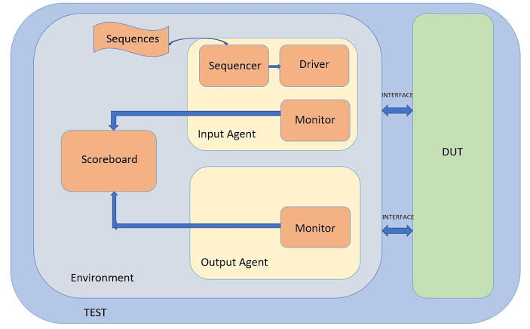
Introduction to UVM
Sequencer: Generates/controls transactions.
Driver: Converts transactions into actual DUT pin-level activity.
Monitor: Observes DUT activity and converts it back into transactions.
Scoreboard: Determines whether the DUT behaved correctly.
Agent: Packages the driver, sequencer, and monitor.
Environment: Contains agents, scoreboards, reference models, etc.

Slide 4
Introduction to UVM
General implementation structure:
Similar in concept to a typical testbench
  Entire design (Design Under Test, DUT) is loaded into verification environment & ran through sequential tests (see previous)
  External checker compares inputs and outputs to determine validity
How is UVM accessed?
Commercial EDA tools tend to include UVM (base class library in SV)
  Top module contains DUT, which connects to UVM test(s) via an interface
  UVM test(s) configure and contain the UVM environment itself

Slide 5
Introduction to UVM
4 major parts: interface, DUT, uvm environment, uvm test
  Parts are written separately and instantiated within top module
Example:
module top;
…
dut_if dut_if1();
dut dut1(._lf(dut_if1));
…
endmodule //can use “endmodule: top” to specify which module to end
For more detail, recommend creating an account and watching “UVM ‘Hello World’” in Siemens Verification Academy’s “UVM Basics” series: https://verificationacademy.com/topics/uvm-universal-verification-methodology/

Slide 6
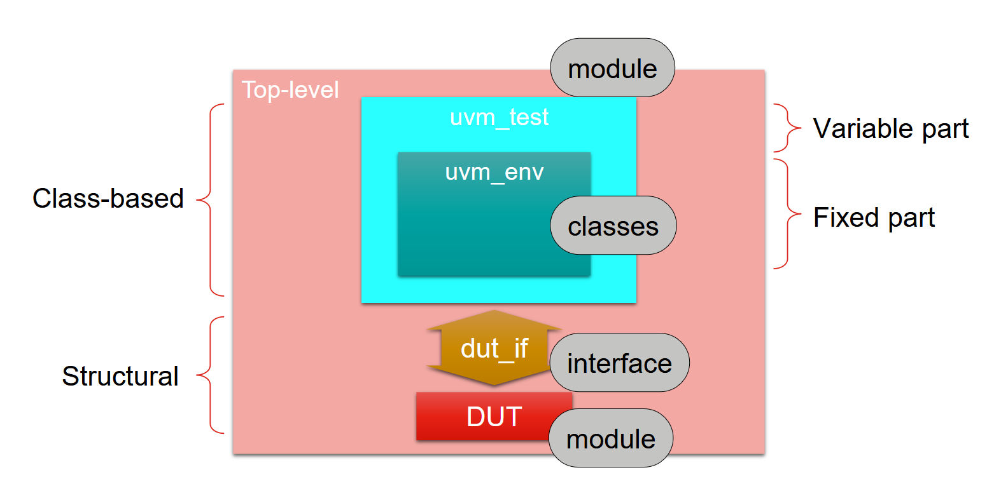
Siemens Verification Academy, UVM Basics (https://verificationacademy.com/topics/uvm-universal-verification-methodology/)

Slide 7
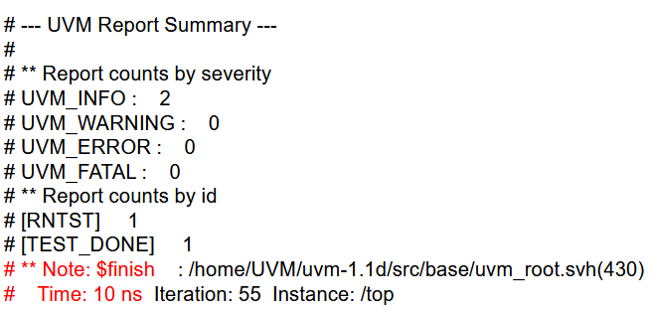
Introduction to UVM
When UVM is finally executed, results are extracted and printed as a “scoreboard”
Details the number of tests run, as well as the number of warnings and errors
Should (ideally) aim for zero warnings; definitively want zero errors or fatal results

Slide 8
The End

